Slide 1
HVAC Technician
Name
Institution
date

Slide 2
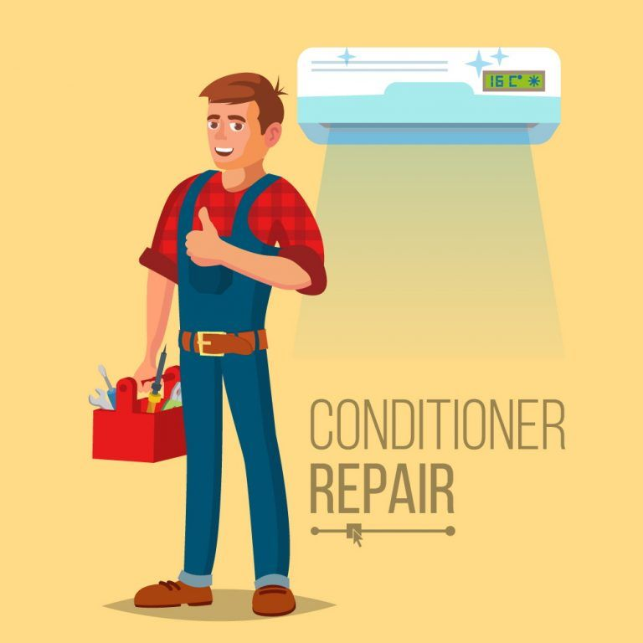
Introduction
A Heating, Ventilation, and Air Conditioning (HVAC) technician is a professional who deals with:
  Fitting and maintenance of air conditioning systems
  Installation and maintenance of heating control systems
  Installation and maintenance of refrigeration systems
This presentation sheds light on components, industries and skills of HVAC technician.

Slide 3
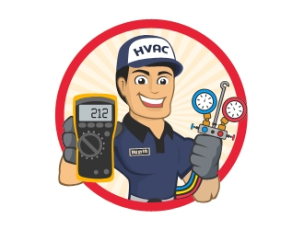
components of an HVAC technician job
Repair
Maintenance
Ductwork
Installation (Akaemeh,2017)

Slide 4
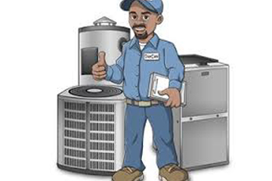
Industries where HVAC technicians work
Wired telecommunication carriers
Repair and maintenance of household gadgets (Silberstein,2020)
National gas distribution companies
Aerospace products manufacturing industries
Heating equipment industries

Slide 5
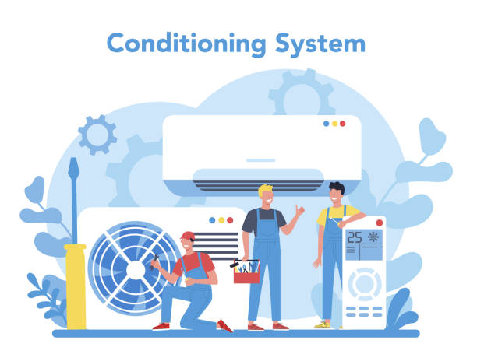
Skills required to be an HVAC technician
Critical thinking skills
Listening skills
Time management skills
Speaking skills

Slide 6
Education and training required for an HVAC technician
Post-secondary education at a technical school
Three to five years of apprenticeship (Piotrowski,2018)
Licensing

Slide 7
Flyer

Slide 8
Excel sheet For duct location

Slide 9
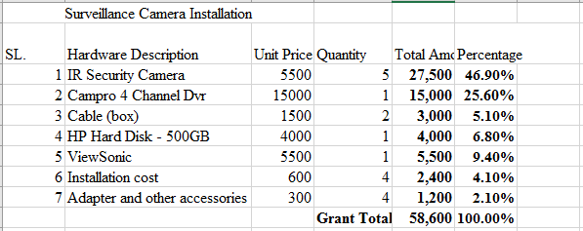

Slide 10
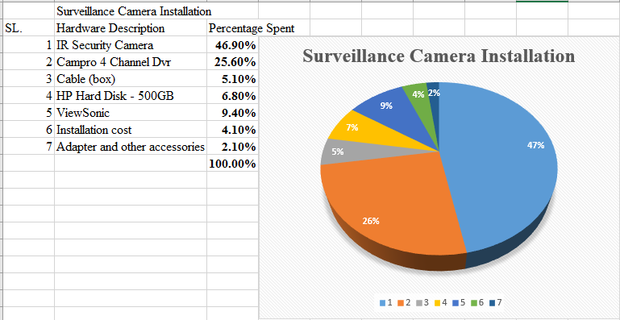

Slide 11
Conclusion
In conclusion, an HVAC technician majors in;
Installation, Repair & Maintenance of
  Refrigeration systems
  Air conditioning systems
  Heat control systems
  Surveillance systems

Slide 12
?

Slide 13
References
Akaemeh, R. (2017). Development of Integrated Modeling Methods for Supporting HVAC Maintenance in Healthcare Centres.
Piotrowski, S. (2018). Growth Projected for Service Technician Careers.
Silberstein, E., Obrzut, J., Tomczyk, J., Whitman, B., & Johnson, B. (2020). Refrigeration and Air Conditioning Technology. Cengage Learning.
Sugarman, S. C. (2020). Testing and balancing HVAC air and water systems. Crc Press.

